Slide 1
Object Oriented Software Engineering (OOSE)
22CS017
Introduction to Interaction Diagrams
Prepared By:
Dr. Shveta Bansal

Slide 2
Contents
Introduction to Interaction diagrams
Purpose of Interaction Diagrams
Draw an Interaction Diagram
Sequence Diagram
Collaboration Diagram
Use of Interaction Diagrams

Slide 3
Introduction to Interaction diagrams
The term “Interaction” denotes that the diagram is used to describe some type of interactions among the different elements in the model. This interaction is a part of dynamic behavior of the system.
This interactive behavior is represented by two diagrams known as
1. Sequence diagram
2. Collaboration diagram.
The basic purpose of both the diagrams are similar.
Sequence diagram emphasizes on time sequence of messages and collaboration diagram emphasizes on the structural organization of the objects that send and receive messages.

Slide 4
Purpose of Interaction Diagrams
The purpose of interaction diagrams is to visualize the interactive behavior of the system. Visualizing the interaction is a difficult task. Hence, the solution is to use different types of models to capture the different aspects of the interaction.
Sequence and collaboration diagrams are used to capture the dynamic nature but from a different angle.
The purpose of interaction diagram is −
To capture the dynamic behavior of a system.
To describe the message flow in the system.
To describe the structural organization of the objects.
To describe the interaction among objects.

Slide 5
How to Draw an Interaction Diagram?
The purpose of interaction diagrams is to capture the dynamic aspect of a system. So to capture the dynamic aspect, we need to understand what a dynamic aspect is and how it is visualized. Dynamic aspect can be defined as the snapshot of the running system at a particular moment.
Two types of interaction diagrams. One is the sequence diagram and the other is the collaboration diagram. The sequence diagram captures the time sequence of the message flow from one object to another and the collaboration diagram describes the organization of objects in a system taking part in the message flow.
Following things are to be identified clearly before drawing the interaction diagram-
Objects taking part in the interaction.
Message flows among the objects.
The sequence in which the messages are flowing.
Object organization.

Slide 6
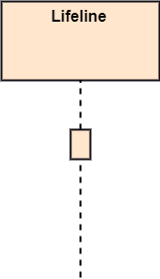

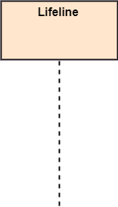
Notations in Sequence Diagram
Lifeline: An individual participant in the sequence diagram is represented by a lifeline. It is positioned at the top of the diagram.
Actor: A role played by an entity that interacts with the subject is called as an actor. It is out of the scope of the system. It represents the role, which involves human users and external hardware or subjects. An actor may or may not represent a physical entity, but it purely depicts the role of an entity. Several distinct roles can be played by an actor or vice versa.
Activation: It is represented by a thin rectangle on the lifeline. It describes that time period in which an operation is performed by an element, such that the top and the bottom of the rectangle is associated with the initiation and the completion time, each respectively.

Slide 7
Types of Messages in Sequence Diagram
Call Message: It defines a particular communication between the lifelines of an interaction, which represents that the target lifeline has invoked an operation.
Return Message: It defines a particular communication between the lifelines of interaction that represent the flow of information from the receiver of the corresponding caller message.
Self Message: It describes a communication, particularly between the lifelines of an interaction that represents a message of the same lifeline, has been invoked.
Recursive Message: A self message sent for recursive purpose is called a recursive message. In other words, it can be said that the recursive message is a special case of the self message as it represents the recursive calls.
Create Message: It describes a communication, particularly between the lifelines of an interaction describing that the target (lifeline) has been instantiated.
Destroy Message: It describes a communication, particularly between the lifelines of an interaction that depicts a request to destroy the lifecycle of the target.

Slide 8


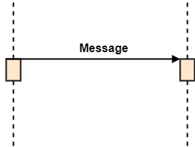
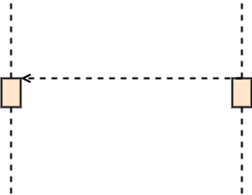
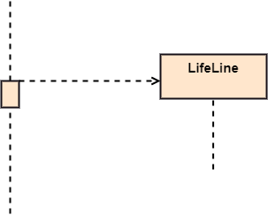
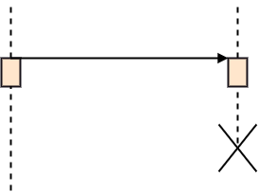
Cont…
Call Message
Return Message
Self Message
Recursive Message
Create Message
Destroy Message

Slide 9
Interaction Diagrams
Example: Order Management System
Key components for an order management system:
Customer: Places an order.
Order Service: Handles order creation.
Special order or Normal order.
Sequence of events:
Customer places an order.
Order Service creates an order.
Order Service checks stock with Inventory Service.
If stock is available, Payment Service is called for payment processing.
Once payment is confirmed, Shipping Service prepares shipping details.
Customer receives order confirmation.

Slide 10
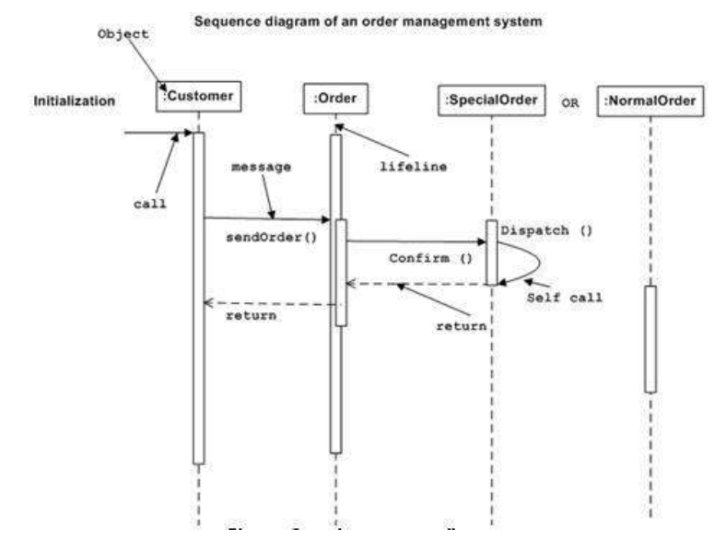
(1) The Sequence Diagram
Figure 1: Sequence Diagram for Order management system

Slide 11
Cont..
The sequence diagram has four objects (Customer, Order, SpecialOrder and NormalOrder).
The following diagram shows the message sequence for SpecialOrder object and the same can be used in case of NormalOrder object. It is important to understand the time sequence of message flows. The message flow is nothing but a method call of an object.
The first call is sendOrder () which is a method of Order object. The next call is confirm () which is a method of SpecialOrder object and the last call is Dispatch () which is a method of SpecialOrder object. The following diagram mainly describes the method calls from one object to another, and this is also the actual scenario when the system is running.

Slide 12
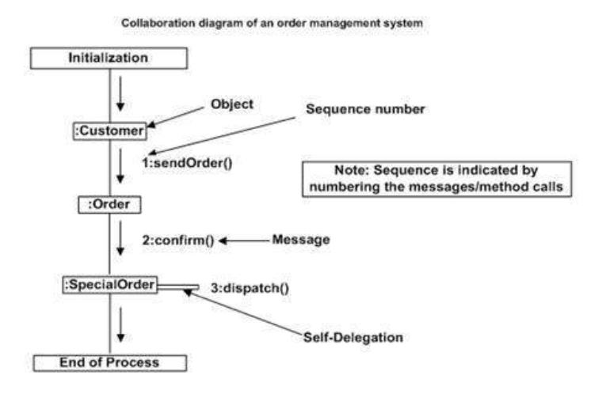
(2) The Collaboration Diagram
Figure 2: Collaboration Diagram for Order management system

Slide 13
Cont..
The second interaction diagram is the collaboration diagram. It shows the object organization as seen in the following diagram. In the collaboration diagram, the method call sequence is indicated by some numbering technique. The number indicates how the methods are called one after another. We have taken the same order management system to describe the collaboration diagram.
Method calls are similar to that of a sequence diagram. However, difference being the sequence diagram does not describe the object organization, whereas the collaboration diagram shows the object organization.
To choose between these two diagrams, emphasis is placed on the type of requirement. If the time sequence is important, then the sequence diagram is used. If organization is required, then collaboration diagram is used.

Slide 14
Where to Use Interaction Diagrams?
The main purpose of both the diagrams are similar as they are used to capture the dynamic behavior of a system. However, the specific purpose is more important to clarify and understand.
Sequence diagrams are used to capture the order of messages flowing from one object to another. Collaboration diagrams are used to describe the structural organization of the objects taking part in the interaction. A single diagram is not sufficient to describe the dynamic aspect of an entire system, so a set of diagrams are used to capture it as a whole.

Slide 15
Where to Use Interaction Diagrams? (Cont..)
Interaction diagrams are used when we want to understand the message flow and the structural organization. Message flow means the sequence of control flow from one object to another. Structural organization means the visual organization of the elements in a system.
Interaction diagrams can be used −
To model the flow of control by time sequence.
To model the flow of control by structural organizations.
For forward engineering.
For reverse engineering.

Slide 16
Examples: Interaction Diagrams

Slide 17
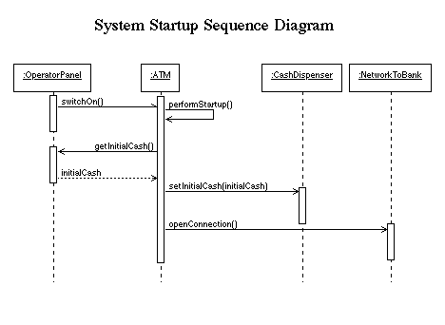
System Start-up Diagram
Figure 3: Sequence Diagram for System Start up

Slide 18
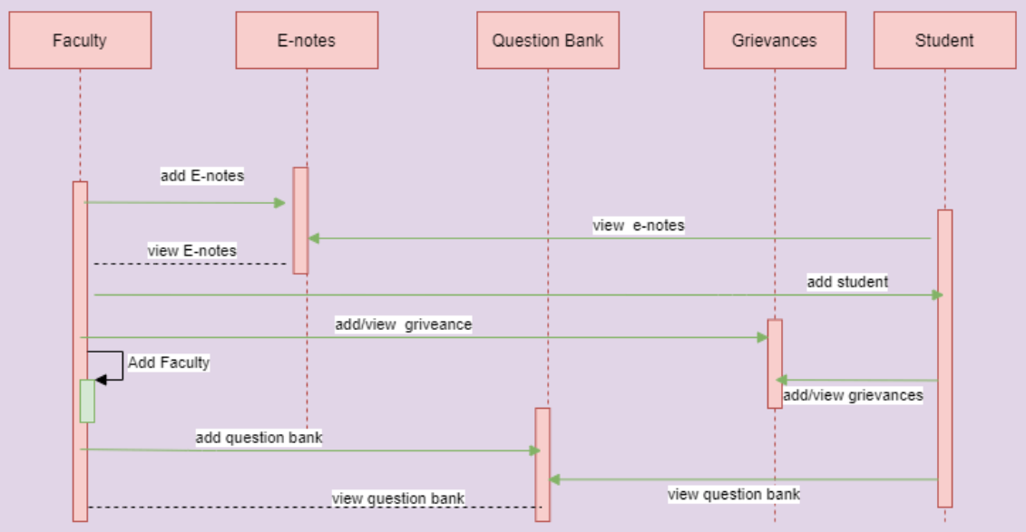
College Management System
Figure 4: Sequence Diagram for College management system

Slide 19
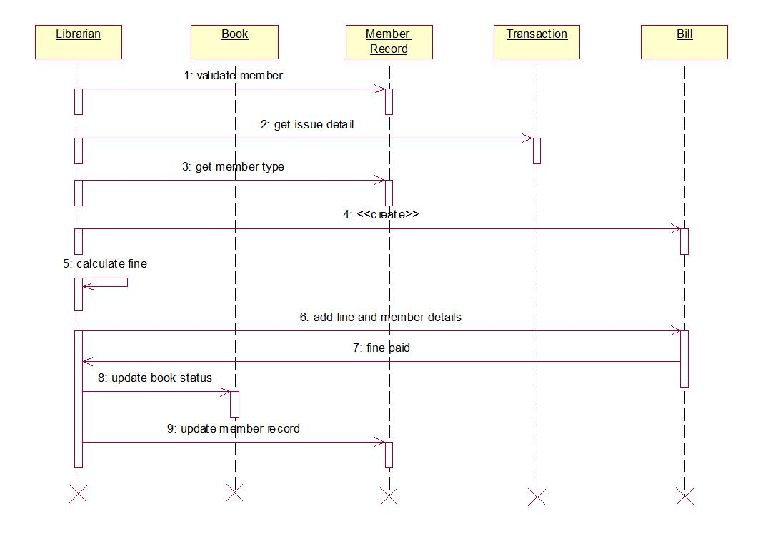
Library management system
Figure 5: Sequence Diagram for Library management system

Slide 20
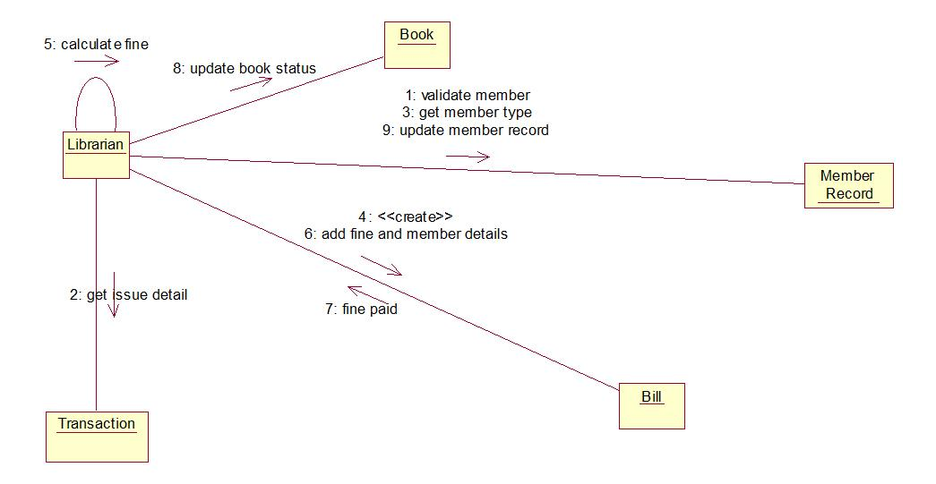
Library management system
Figure 6: Collaboration Diagram for Library management system

Slide 21
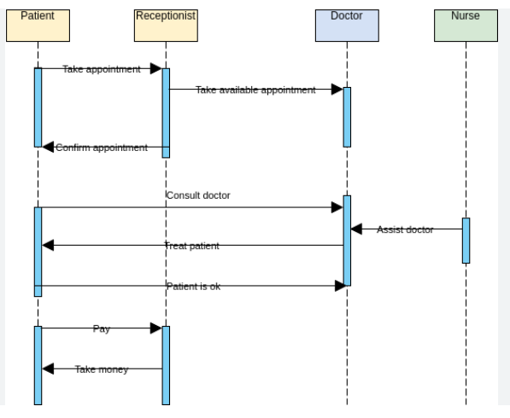
Interaction diagram of Hospital management system
Figure 7: Sequence Diagram for Hospital management system

Slide 22
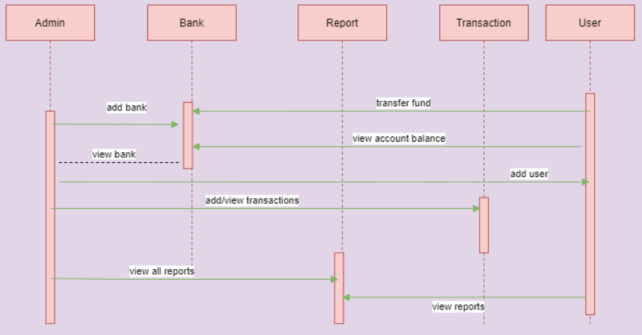
Interaction diagram of Banking system
Figure 8: Sequence Diagram for Banking system

Slide 23
Practice Questions ?
Draw the collaboration diagram for College information system.
Draw the collaboration diagram for Library Management system.
Draw the collaboration diagram for Hospital Management System.
Draw the collaboration diagram for Banking System.

Slide 24
Bibliography
https://codebun.com/uml-diagram-for-bank-management-system/
https://www.freeprojectz.com/uml-diagram/college-management-system-sequence-diagram
https://www.tutorialspoint.com/software_testing_dictionary/alpha_testing.htm
https://www.tutorialspoint.com/software_testing_dictionary/validation_testing.htm
https://www.tutorialspoint.com/software_testing_dictionary/acceptance_testing.htm

